Slide 1
Slices - a highly portable gateway to your app
Hieu Rocker
Notes:
Hello everyone

Slide 2


GDE Android
Tech Lead at Zalo
https://github.com/rockerhieu

Slide 3


Slide 4


Slide 5
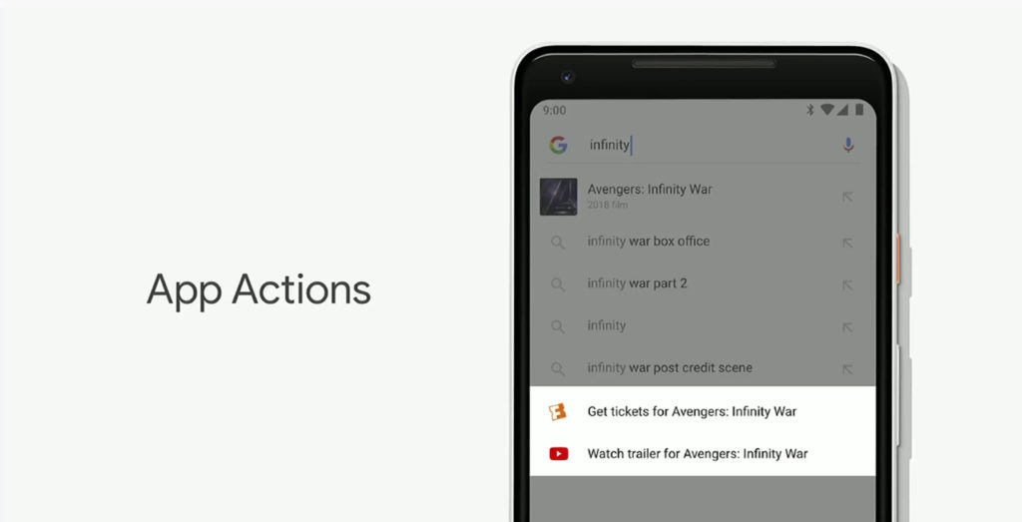

Slide 6
Actions
Pre-defined set of intents
Integrate with Google Assistant
Register custom intents

Slide 7
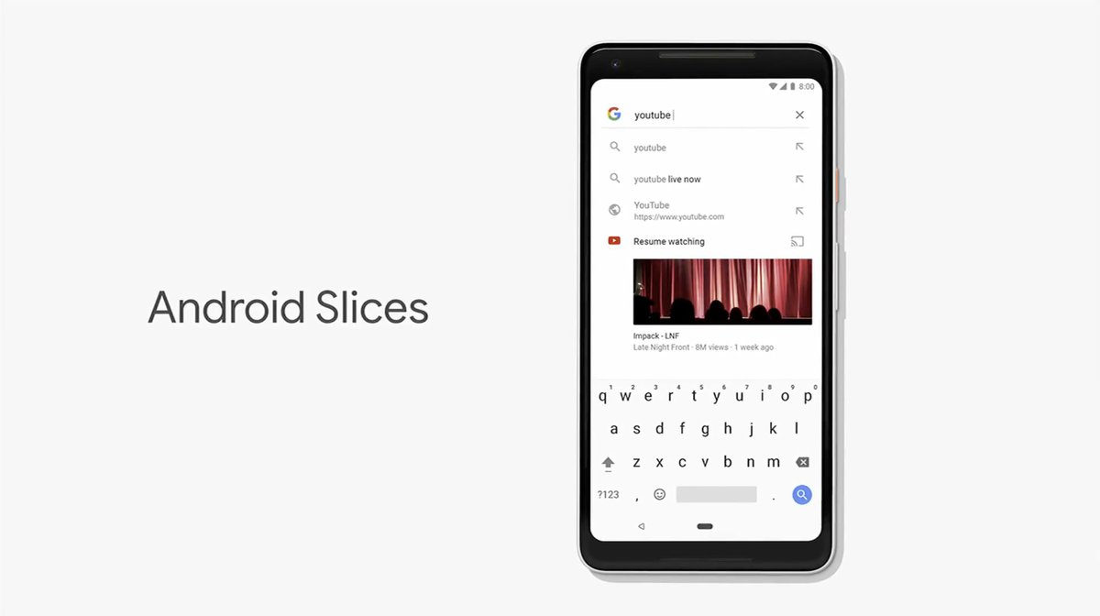
http://g.co/slices

Slide 8
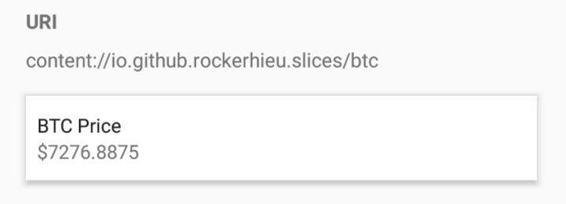
actions.xml
SliceProvider
Intent / Deeplink
actions.intent.GET_CRYPTOCURRENCY_PRICE

Slide 9
Slices
TL;DR: RemoteViews 2.0
SliceProvider
act as a ContentProvider
emits Slice
SliceManager
Bind, pin, interact with Slice
SliceView#setSlice(slice)
Provider App
Host App
SliceProvider
SliceManager
SliceView

Slide 10
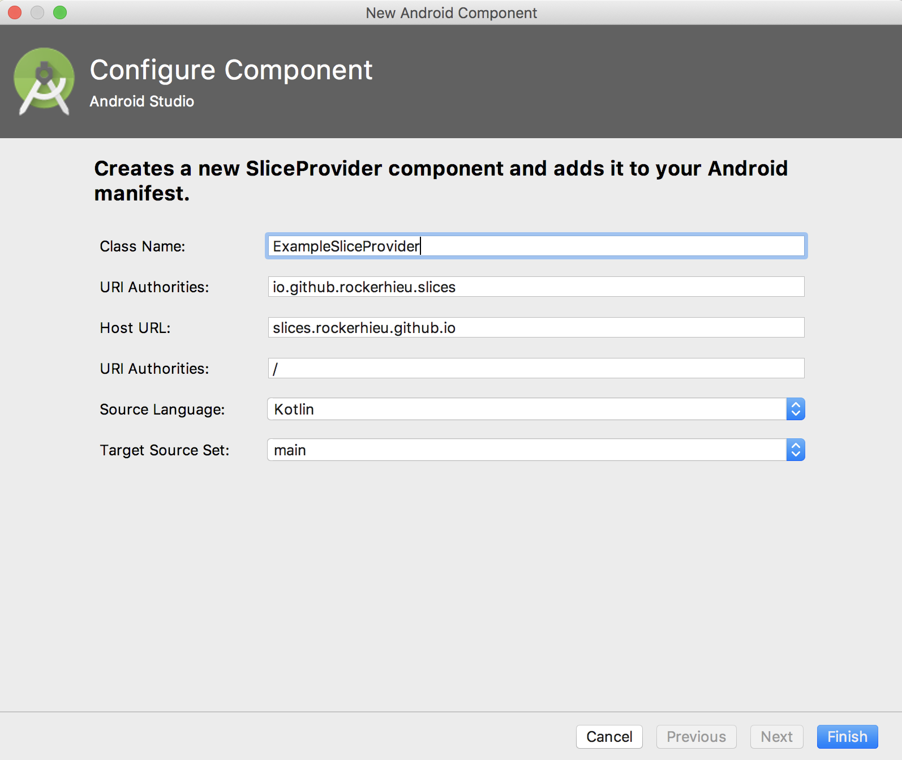
Create a new SliceProvider
Android Studio 3.2 Preview: File -> New -> Other -> Slice Provider

Slide 11
Getting Started
Install Slice Viewer: https://github.com/googlesamples/android-SliceViewer/releases
Create a SliceProvider and deploy
Launch your SliceProvider
adb shell am start -a android.intent.action.VIEW -d slice-<your slice URI>

Slide 12
SliceProvider in AndroidManifest.xml
<provider
android:name=".ExampleSliceProvider"
android:authorities="io.github.rockerhieu.slices"
android:exported="true">
<intent-filter>
<action android:name="android.intent.action.VIEW" />
<category android:name="android.app.slice.category.SLICE" />
<data
android:host="slices.rockerhieu.github.io"
android:pathPrefix="/"
android:scheme="https" />
</intent-filter>
</provider>

Slide 13
SliceProvider
class ExampleSliceProvider() : SliceProvider() {
// …
override fun onBindSlice(sliceUri: Uri): Slice {
// build and return the Slice associated with the URI passed in.
return buildSlice(sliceUri) // method defined later.
}
}

Slide 14
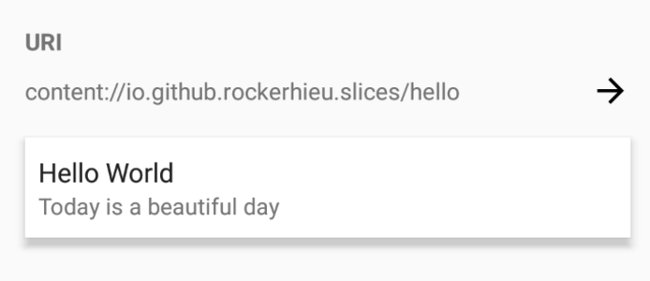
Slice - Hello World
private fun buildSlice(sliceUri: Uri): Slice {
return list(context, sliceUri, ListBuilder.INFINITY) {
header {
title = "Hello World"
subtitle = "Today is a beautiful day"
}
}
}

Slide 15
Slice Builders
// add slice builders dependency in build.gradle
implementation "androidx.slice:slice-builders:<current version>"
// DSL for slice builders
implementation "androidx.slice:slice-builders-ktx:<current version>"

Slide 16
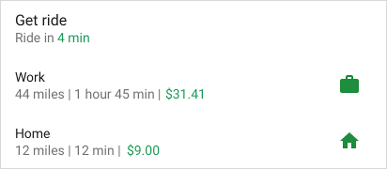

Slice Templates - HeaderBuilder
https://developer.android.com/guide/slices/templates

Slide 17




Slice Templates - RowBuilder

Slide 18

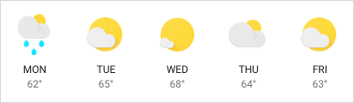

Slice Templates - GridBuilder
Slice Templates - GridBuilder

Slide 19


Slice Templates - RangeBuilder

Slide 20
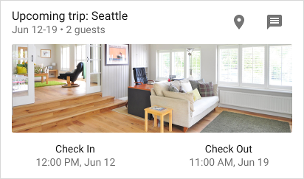
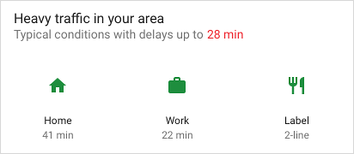
Slice Templates - Combine Templates
Header + grid 3 cell of image + grid 2 cells of list
Header + grid 1 cell of image + grid 2 cells of text

Slide 21
More Resources
http://g.co/slices
http://g.co/actions
https://github.com/googlesamples/android-SliceViewer/

Slide 22


Slide 23


